Slide 1

CWC Coaching Rates
Program Details & Pricing
Executive Leadership and Life Coach, Wendy Perdomo, M.P.A., M.S.Ed

Slide 2
Introduction
Congratulations on taking such a bold step toward exploring coaching—this is only the beginning! Whether you’re unsure about your next professional or personal move, eager to fast-track your career, a woman of color confronting systemic challenges and underrepresentation in your field, or in need of support to rise to the demands of a new role—know that you are in the right place.
Take a moment to review all that’s included in our one-on-one coaching program and learn more about the powerful results we’ve helped our clients achieve.
If you have questions, I encourage you to bring them to our upcoming consultation or feel free to
email me at wendy@coachingwomenofcolor.com

Slide 3
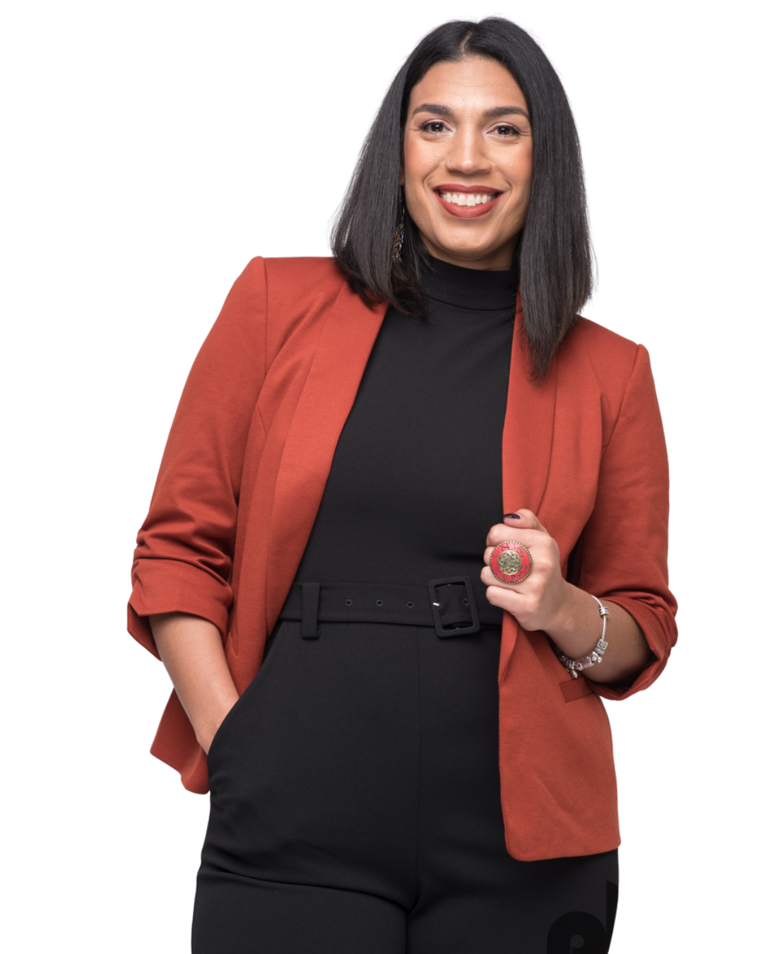
About Your Coach
Who Am I?
Executive Leadership & Life Coach
Twenty five years of non-profit education reform & leadership experience
Non-Profit Executive
Certified Coach & Owner of Coaching Women of Color
International Speaker
Key Areas of Expertise:
Professional Learning
Communication Expert- Certified DiSC Facilitator
Leadership Development
Women of Color
Executive Coaching to Senior Leaders & C-Suite Executives
Performance Management
Employee Relations
Positive Intelligence
Courageous Conversations
Manager Training & Resources
Leadership Training Program Design
Diversity, Equity, Inclusion
Trauma Informed Advocate
Wendy Perdomo

Slide 4
One-on-One Coaching Program Details
Program includes:
12 coaching sessions that is your dedicated unbiased time to work through your most critical challenges.
Spot coaching in between sessions if anything urgent emerges
Unlimited session recording for you to revisit a-ha moments and dive deeper into your leadership insights on your own time.
Unlimited Text or Whatsapp Support for those moments when you need support fast.
Actionable Documents and templates to take the guesswork out of how to best communicate these new leadership frameworks in your work and with your team.
Notes:
3 - 1 hour call
Aha’s, new awareness, breakthroughs, unstuck
Whats App Texting with 24 hour response time
In the moment support/brainstorm
Negotiation tips
Persuasive language to support you during a moment of indecisiveness or lack of clarity buy in on decision-making
Talking Points to support or guide an impending conversation or negotiation
Action Plan Template
Additional templates and resources
Action Plan will provide you with 6 month clarity on next steps in your goals

Slide 5
Your Investment: 6-month minimum commitment
Total Investment: $9,900
Flexible Payment Plan: $1,650/month
We begin with a Kickoff Onboarding Process to set the foundation for your success:
Comprehensive Personal Assessment to define where you are now, where you want to be, and the exact milestones to get you there.
Positive Intelligence® and DiSC® Assessments to uncover your unique strengths, potential saboteurs, and preferred leadership/communication style.
Welcome Packet with resources to help you start strong and stay organized.
Throughout your journey, you’ll have access to powerful tools and exclusive resources, including:
Client Google Folder with shared access to all resources, notes, and action plans.
All Recorded Coaching Sessions so you can revisit insights and strategies anytime.
Access to Custom Templates to streamline implementation and decision-making.
Document Review & Feedback—upload files directly to your folder for my eyes and recommendations between sessions.
Spot Coaching- contact coach for urgent and immediate executive coaching support.
Notes:
At the close of our six months, we revisit your initial assessment to measure your progress and celebrate your transformation, giving you a tangible record of the growth you’ve achieved.This is more than coaching. It’s a proven, structured investment in your growth, your leadership, and your future success.

Slide 6

REAL TRANSFORMATIONS:
CLIENT TESTIMONIALS

Slide 7

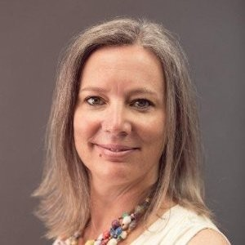
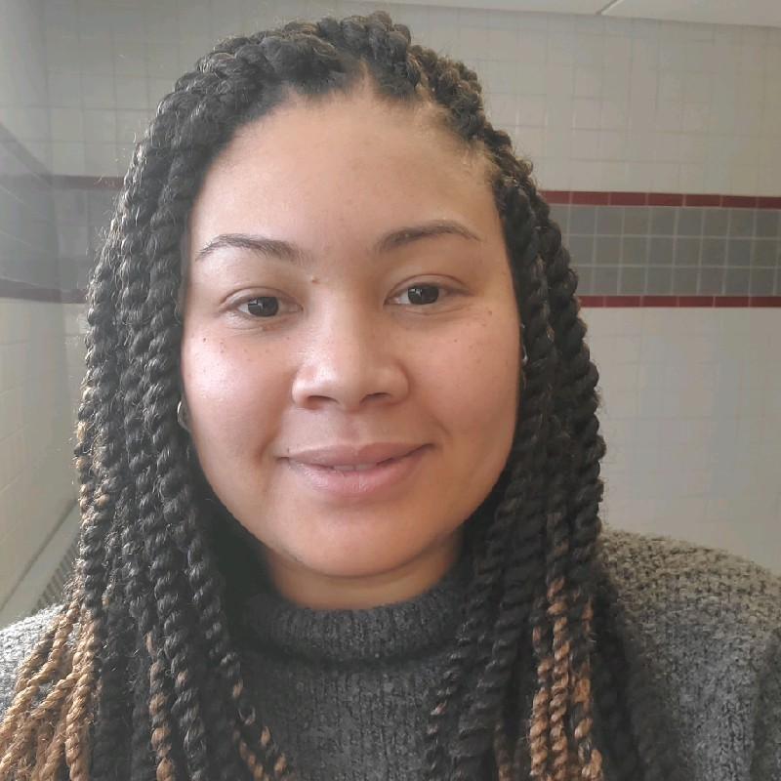
Client Testimonials
Wendy is an incredible coach who understands women of color and helped me feel seen, heard, and understood. She approached all of our sessions with patience, grace, and compassion. Even so, she wasn't afraid to share hard truths and insights that supported my personal and professional journey during our year of working together. Connecting with Wendy was typically the highlight of my week, as it gave me the opportunity to reflect and troubleshoot issues I was experiencing at work in a supportive and non-judgemental environment. My experience with Wendy transformed coaching from a mere task on my to-do list into a nurturing experience that truly supported my growth. I highly recommend Wendy to anyone looking for a transformative coaching experience.
Stephanie Lopez, California
I started working with Wendy prior to assuming a position of leadership in my university. I was concerned about my ability to step fully into the role and gain the respect of my peers, in order to transform my workspace into a high functioning team. Wendy pushed me to consider my strengths and how to apply myself for best results. She also helped me work through difficult issues that I encountered by brainstorming solutions that work for me. The customized attention and sage advice made all of the difference on my journey, and has helped me maintain the energy and enthusiasm for the road ahead."
Lisa Morgan, Ontario, Canada
Wendy's life and leadership coaching program has successfully equipped me with the effective mental mindset tools and techniques to overcome my own "analysis paralysis." She has supported me in developing a deeper self-awareness and increased accountability towards my proposed life and career goals. As CEO & Founder of P2P, some of my accomplishments include:
Served as a guest speaker and participated in vending opportunities at various women's empowerment events
Featured guest on the Donna Drake Show/Live It Up to discuss my business (show aired on both NBC and CBS)
Currently working on my second book soon which is soon to be published
Decided to take control of my health and became a gym member
Released 30 lbs. of weight since I have been exercising after several months.”
Nicole Carr, Long Island, New York

Slide 8
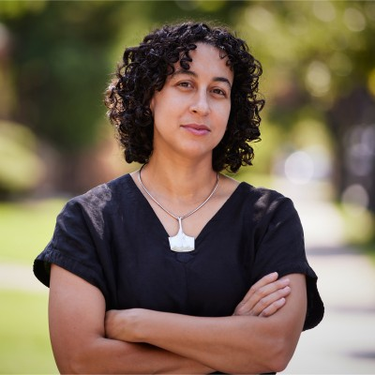
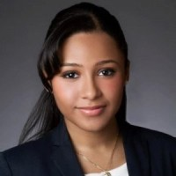
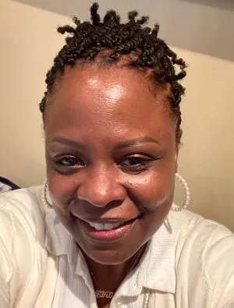
Client Testimonials
I recently began a mid-career exploration of what new professional chapters might lie ahead and reached out to Wendy to help me polish my (dusty) CV. During our consultation call, it quickly became apparent that Wendy could offer me so much more than resume editing -- her dynamic personality and candor captured my attention immediately and so began my first coaching experience. I learned so much about myself while working with Wendy. Her careful listening and encouragement during each session combined with the innovative tools and resources that she shared helped guide me towards new ways of thinking about my strengths, skills, and abilities. This was only made more meaningful by Wendy sharing with me her own lived experience as a woman of color. Being able to connect so openly and honestly with someone who could relate how I moved through the world was an absolute gift.
Nicole Vlado, Brooklyn, NY
I was able to accomplish nearly everything in my action planning document. At the beginning of the cohort, I was jobless and depressed. Being a part of the cohort and working on my action planning document allowed me to achieve my goals alongside others who would hold me accountable. If there is anyone I would recommend as a coach, it's Wendy. She challenged me to not make excuses and to hold myself accountable. She reminded me that there is a beautiful life on the other side of fear.
Tiffany Cordero, Bronx, NY
At any stage of your career or life journey, along the way you can get stuck. At the time I reached out to Wendy, I was a retired educator struggling to craft a plan to define a new identity.I chose to be coached by Wendy because I TRUSTED that she would help me to break through the barriers that were holding me back from achieving my next level dreams and goals. Wendy helped me to create a blueprint for my second act after retirement. Her approach was uniquely crafted and tailored specifically to my needs. She helped me to quickly identify my stuck spots, challenge my limiting beliefs and to recognize and embrace all of the tools and resources around me that would facilitate my transformation.I appreciated being coached by Wendy and I feel that she has established a unique approach to personal growth and development. Wendy listened and was attentive to my specific needs. She is straightforward and her coaching conversations always felt highly individualized. Wendy’s coaching gave me the opportunity to craft a powerful and compelling growth plan with self-created time frames. My work with Wendy was indeed challenging and thought provoking but certainly more than worth it and with her encouragement, inspiration and support, I did indeed accomplish my second act dream of graduating from Fashion Institute of Technology as a Costume Designer and Wardrobe Technician. I highly endorse Wendy as a professional coach.
Lori Bennett, Brooklyn, NY

Slide 9

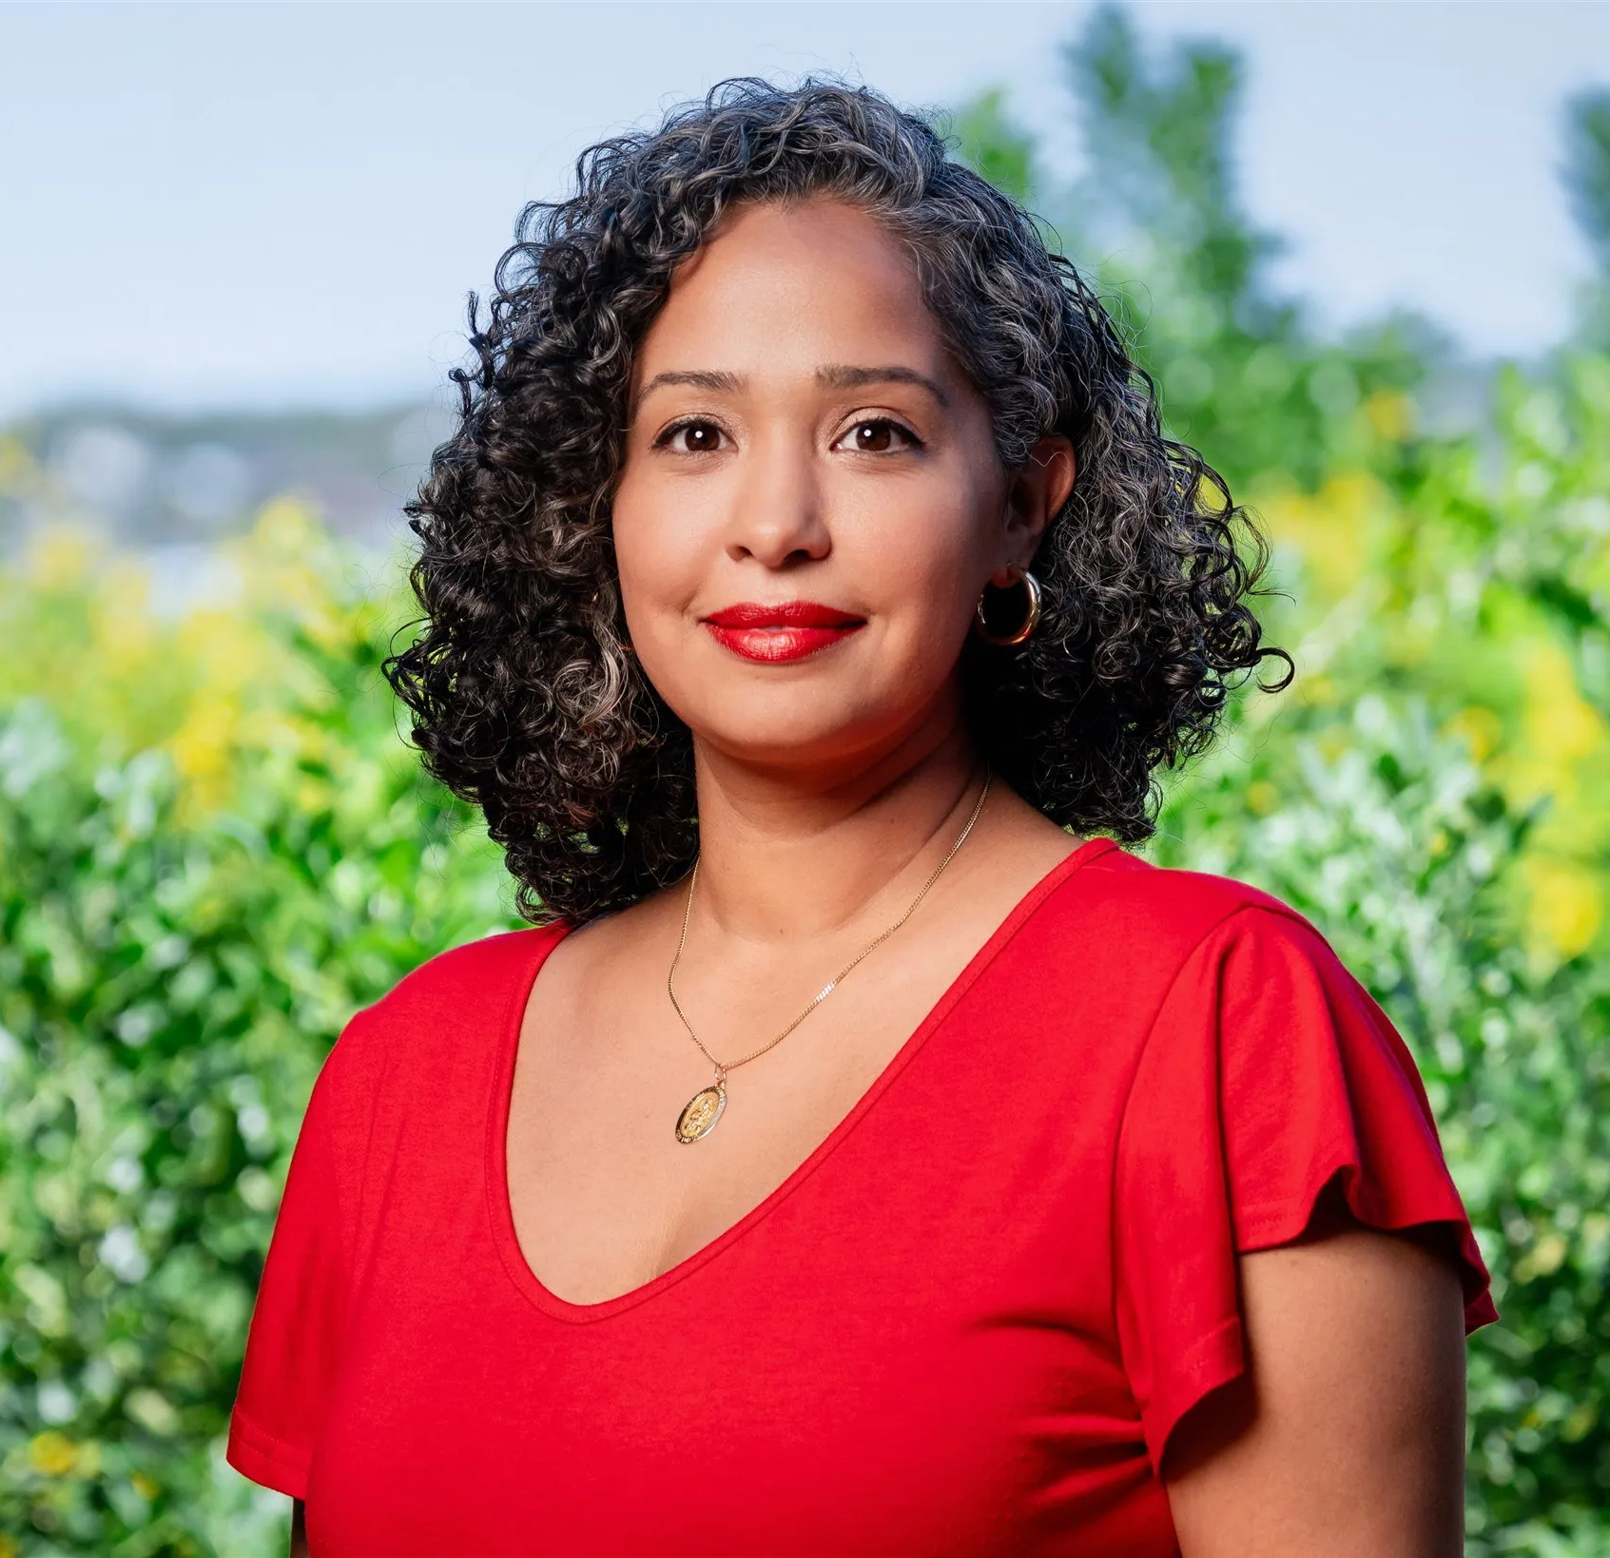
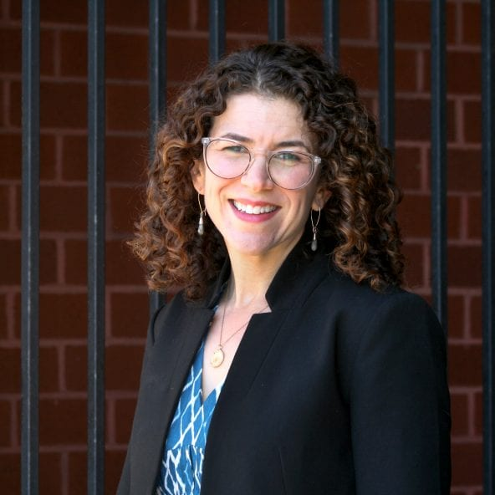
Client Testimonials
I really appreciate you and the coaching that I’ve had with you. Coming to this place has been huge. I recognize that because of the conversations that we've had and the calls that we've had, without them I don't think I wouldn't have gotten here, or I wouldn't have gotten here as quickly as I have. So I appreciate your perspective. I appreciate you challenging me, I appreciate you, showing me so much of myself and peeling back layers. I was able to really hone in on what's really in here to help others discover that as well. Thank you for what you do. I'm so excited for what the future holds for me.
Morgan Bullock, Atlanta, GA [shortly before launching Sportswomen.co]
I had met Wendy and participated in her Women of Color series in 2020 while undergoing some serious challenges with a previous role. During that time, Wendy provided some great feedback that resonated with me so when I had the opportunity to work with her as my Executive Coach, it was a no brainer. Wendy has a holistic approach to coaching, seeing me not only as a professional, but as the multi faceted woman that I am. Wendy seamlessly creates a safe and non judgmental approach all while thoughtfully holding the mirror to some of my thoughts and actions that did not serve me. I cannot recommend Wendy enough.
Patricia Quintero, New York, NY
Working with Wendy kept me steady in a very, very difficult year. And not just me, but my colleague as well. The relationship has changed the emotionality of the workplace, allowing for better collaboration and better outcomes.”
Emily Kurtz, Brooklyn, NY

Slide 10
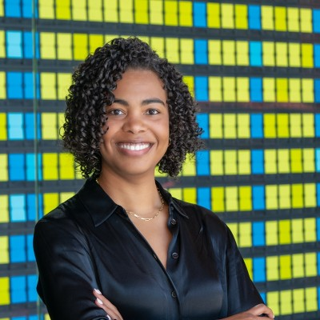
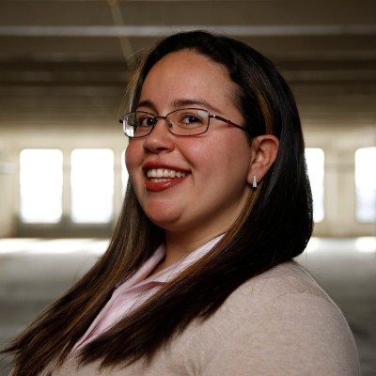

Client Testimonials
Wendy is an amazing coach and an inspiring leader. I feel deeply appreciative of Wendy's support during some professionally challenging months. She catered our sessions to my needs, even when I didn't know what I needed, I am better at identifying, setting and communicating my boundaries. I feel more confident in my decision-making skills as it relates to my professional growth. Wendy is also just a dope human-being with amazing experience and I genuinely enjoyed meeting with her during our coaching calls.
Alexis Brown, Washington, D.C.
I wanted to share some amazing news. I wanted to let you know that I am so grateful for your services and skills because I got an off cycle raise and it was huge. And they want to give more opportunities so I'm training my team up for the next level.
Melissa Delgado, California
With your coaching, I feel a sense of responsibility and purpose, but also potency and power. You said something to me that changed everything: ‘You are not there to become an executive in the way that you're imagining it, you are there to become you and for the system to shift around you.’ You don't have to conform to a toxic system. You are there to bring something that is nourishing into a toxic system and that has changed everything like I am what an executive can be, I don't feel like I'm trying to become anything other than myself.I know who I am in the world now, and I know the ancestors I carry with me, and I know what they have done. I feel like my roots are back, and I know what they are, and I've never really had that in this way. And to just see a person, you, who has done so much work to be embodied in her own power, and is looking back at me that looks a little like my face is just…priceless.
Catarina Campbell, Vermont

Slide 11
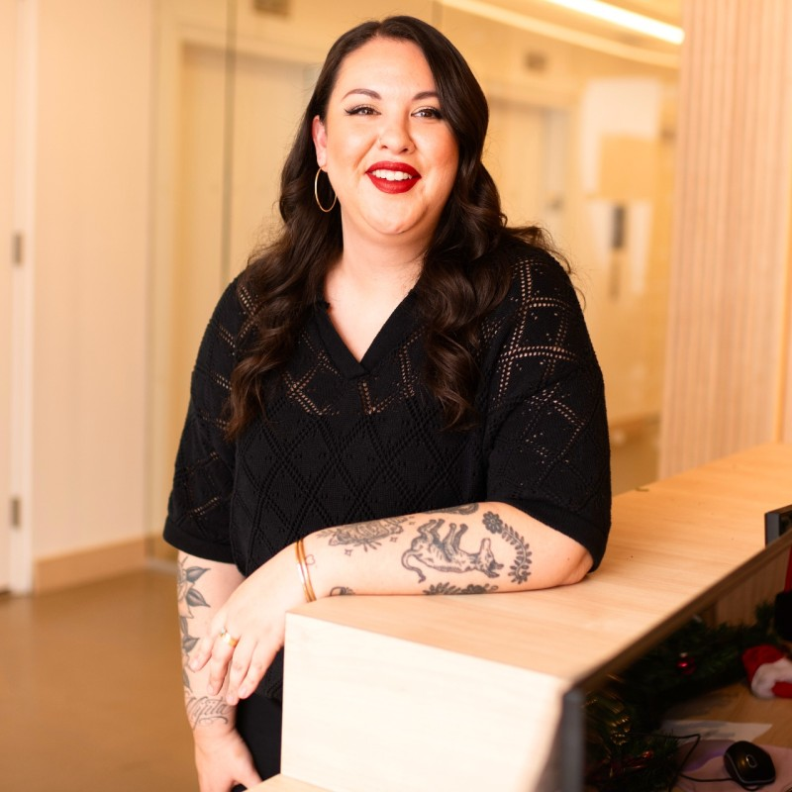
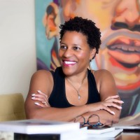
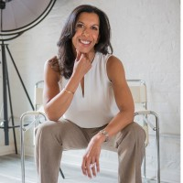
Client Testimonials
Wendy is an incredible coach and advocate for her clients. I worked with her for 6 months and found her guidance invaluable. She helped me grow as a professional and gave me tangible tools to use to better myself as leader. I highly recommend working with Wendy, she is the absolute best!
Teal Inzunza, New York, New York
Wendy facilitated a board retreat for us. She is a brilliant facilitator whose empathetic approach builds trust quickly. Wendy’s superpower is the speed with which she is able to assess needs, navigate dynamics, and coalesce groups around shared goals. We were extremely pleased with the quality and clarity of Wendy’s preparation, delivery, and follow up. She is in a class by herself! I would recommend her without hesitation.
Lynne Toye, Newark, NJ
Wendy Perdomo is in a class by herself; they truly broke the "mold" with her. Ms. Perdomo's level of expertise, compassion and ability to engage, inform and foster meaningful connections, and discussion, sets her apart from other coaches and facilitators. Her ability to connect with people and ensure that those she is working with get the most out of any engagement is truly unparalleled. She creates a collaborative atmosphere that is also thought provoking. I can't thank her enough for creating a space where growth and learning could thrive.
It has been both an honor and privilege to work with Wendy. I have left all our interactions inspired and excited for what is yet to come. Wendy is a thoughtful leader who truly cares about supporting and developing her team, her colleagues, her clients and any organization that she serves, She is a high impact leader who authentically mentors and coaches. I can not recommend her enough!
Tanya Ramos-Puig, FL

